Slide 1

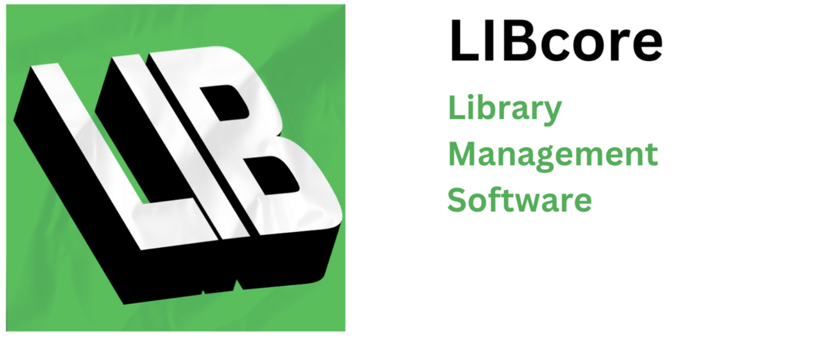
LIBcore
Final Phase
Alejandro Fernandez Steven Le Thomas Tran Kartik Tripathi (KT)

Slide 2
What exactly is LIBcore?
It's a complete library management system built in Java. The system includes both the front-end and the back-end, meaning I created the visual interface users interact with, as well as the logic behind the scenes that makes everything work.
Imagine a digital version of your local library. You can log in, search for books, borrow them, return them — all from a computer. That’s what LIBcore does. It’s designed for two types of users: library staff and regular members. It runs entirely on Java, and doesn’t require the internet or any special software — just Java installed on the computer.

Slide 3
Previous Phases Overview
Recap of Phase 1:
Outlined functional & non-functional requirements
Designed file-based session & data storage
Defined core modules: User, Resource, Transaction, LoanHistory, Inventory
Additions in Phase 2:
Added architectural context to design choices
Defined multithreaded client-server model (Staff client GUI, server backend)
Introduced message-handling logic with enums
Added network communication module
System Architecture:
Client-Server Communication Model
Staff (Client GUI) → Server (Request Handling)
Use of ClientHandler for multithreaded requests
Message object encapsulates data transfer (uses Enums)
Stored and retrieved from structured .txt files

Slide 4
Who can use LIBcore?
There are two types of users:
Staff users, like librarians, can add new books to the system, view who’s borrowing books, and help people return items.
Members, like students or regular visitors, can log in, see what books are available, borrow them, and return them when done.
The system knows what type of user you are based on your login credentials, and it only shows you the features you're allowed to use.

Slide 5
How Does LIBcore Work Behind the Scenes?
LIBcore is built using a model called client-server architecture. That means there are two parts: one part runs on the user’s computer (the 'client'), and another part runs in the background as the 'server'.
The client is what you see — the login screen, the tables, the buttons. It’s built using Java Swing, which lets us create windows, forms, and tables.
The server is where the brain of the system lives. It handles login, keeps track of borrowed books, and enforces rules like session timeouts.
The client and server talk to each other using something called sockets — like digital wires that send text messages between two programs.

Slide 6
Core Features of LIBcore
Login system: You can only get in if your user ID and password match.
Resource viewing: You can browse a list of books — called 'resources'.
Borrowing books: Double-click any available book to borrow it.
Returning books: Fill out a simple form to return items.
Staff-only features: Add books, view user list, and transaction logs.
Session timeout: If you go idle for more than 30 seconds, the system logs you out for security.

Slide 7
Member GUI Walkthrough

Slide 8
Staff GUI Walkthrough

Slide 9
How the Server Services are Organized
AuthenticationService.java: Checks if a user’s login is correct.
ResourceManager.java: Manages all book data — loading, updating, and saving.
TransactionManager.java: Handles borrowing/returning history.
UserManager.java: Retrieves information about all users.
SessionManager.java: Manages sessions. It tracks which users are active.

Slide 10
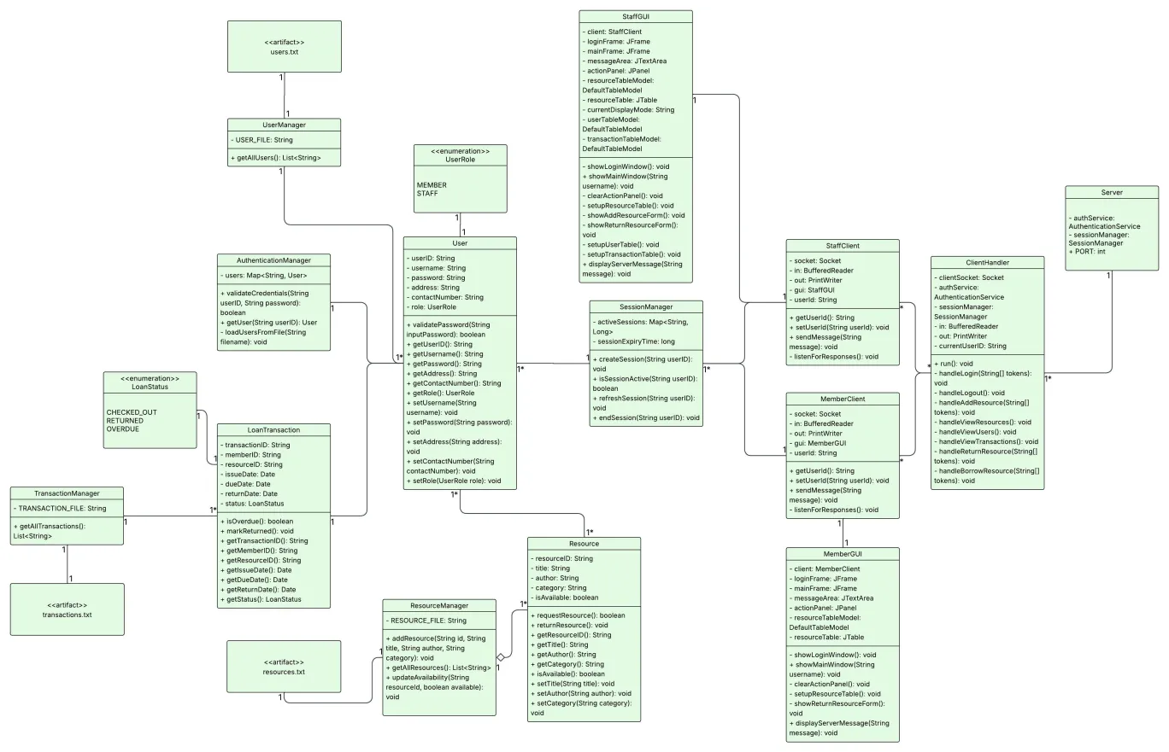
UML Class Diagram
Additions made from the past class diagram since then:
Diagram was updated to include additional classes added during development that weren’t on the old diagram
Also now includes the text files that would store data of users, resources, and loans
Includes GUI and Multithreaded Server Client Design through TCP/IP

Slide 11
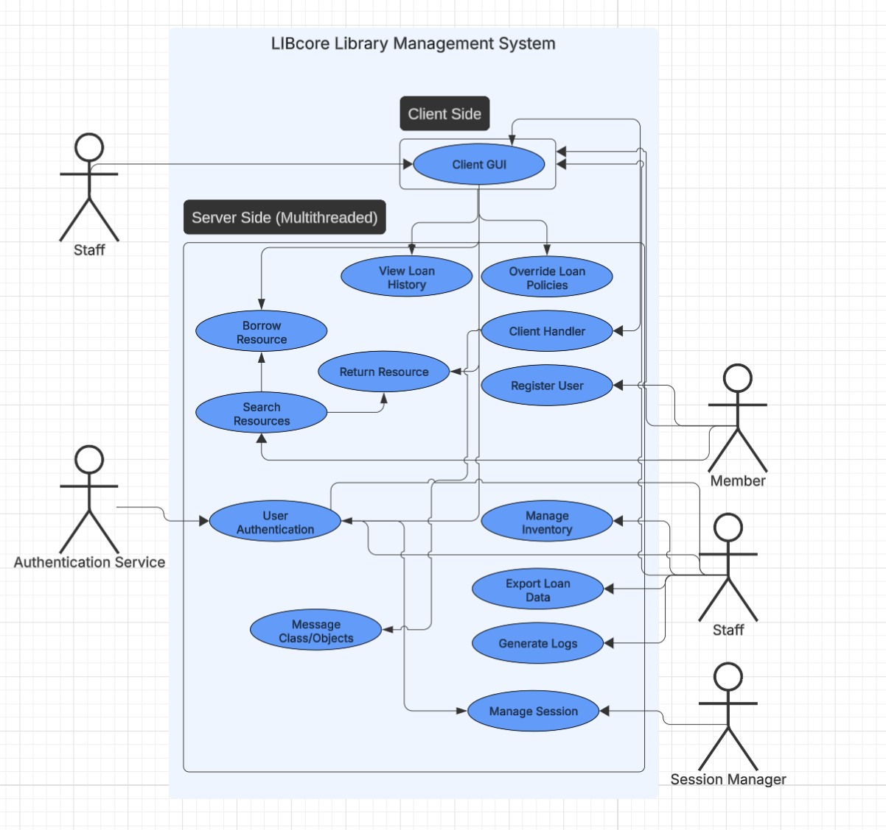
Use Case Diagram
this diagram shows the roles of each actor:
staff can do everything — login, manage books, users, manage inventory, export loan data, generate logs, and view history
members can only login, borrow, and return
- it helped guide the feature design and gui layout.

Slide 12
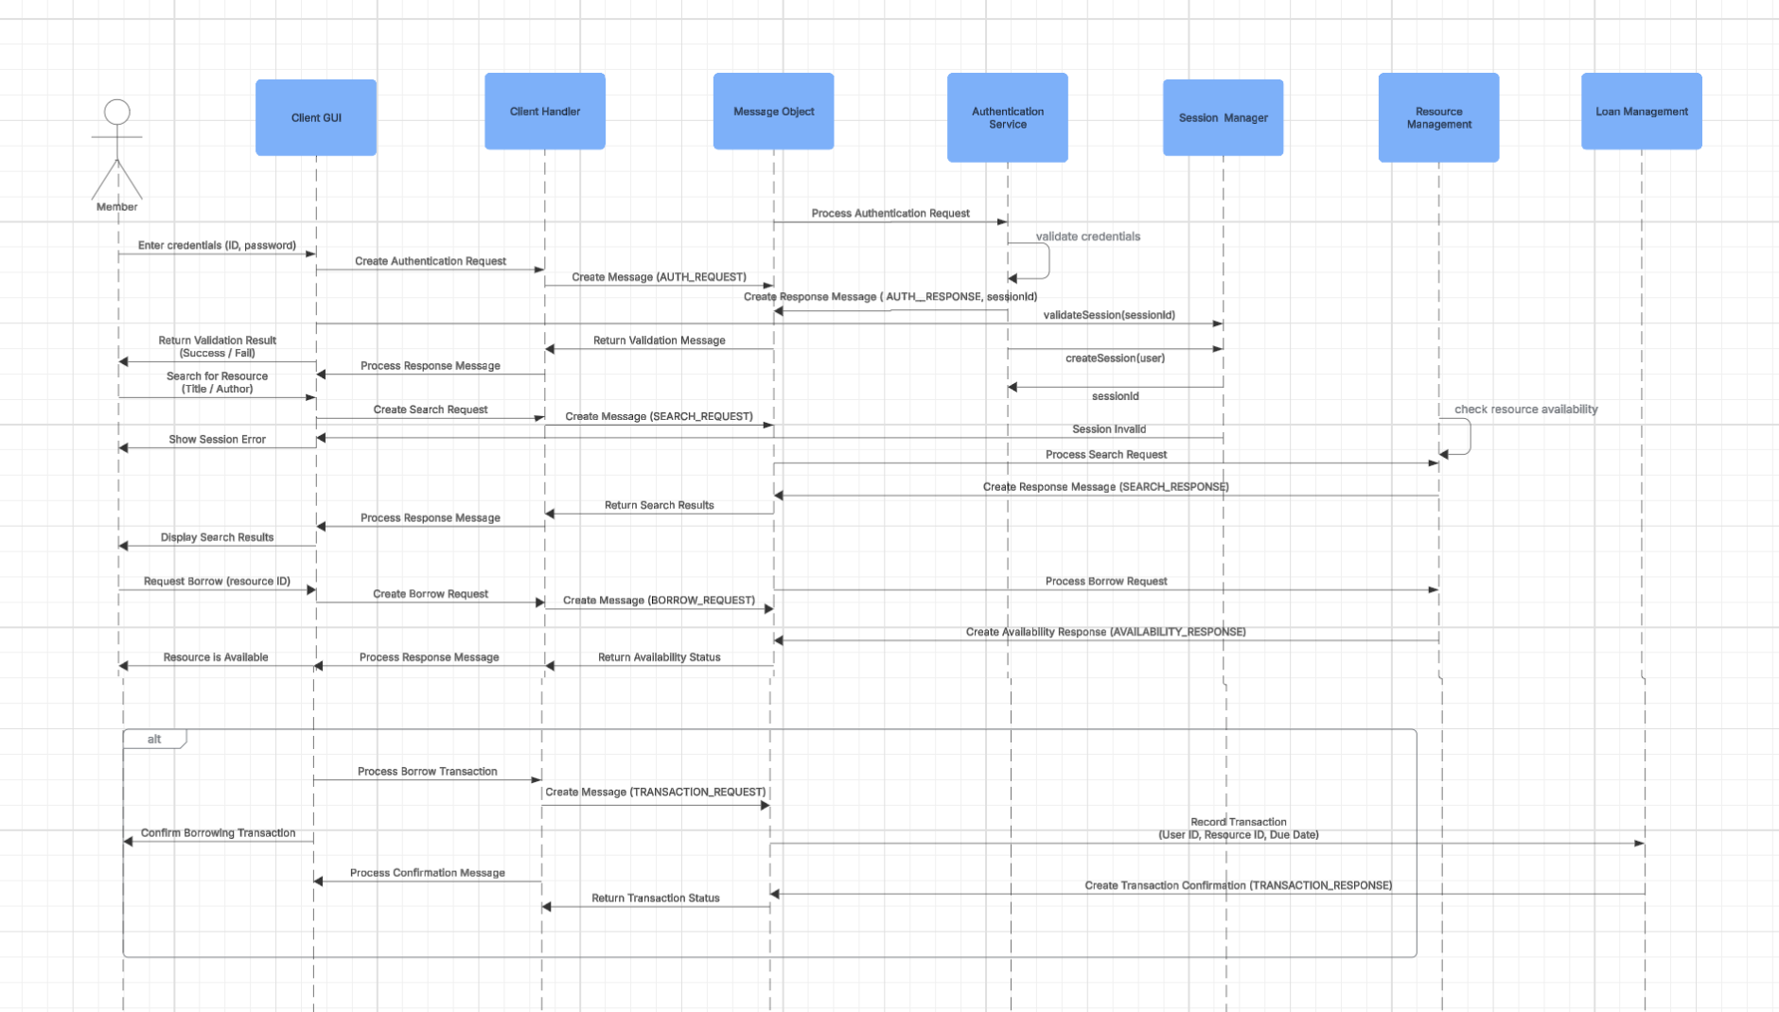
What happens when you borrow a resource?
What was added: Session Manager, and other core for creation of Session and validating requests. which finalizes our Sequence diagram
Borrowing a book walk through: - member double-clicks a row in table
- client sends a message to the server like: ‘borrow_resource,userid,bookid,date’ - the server checks if the book is available
- if yes, it marks the book as unavailable and logs the transaction
- it sends a message back, and the gui updates

Slide 13
Session Timeout Explained Simply
We want to make sure users don’t stay logged in forever.
To do this, we use something called a HashMap — a data structure that stores key-value pairs. Imagine a notebook where we write:
'UserID: LastActiveTime'
Every few seconds, the server checks that list (run function in clienthandler). If someone hasn’t done anything for 30 seconds, it logs them out and tells the client. The GUI immediately shows the login screen again.

Slide 14
Testing
No project is complete without testing. We used JUnit 5, a popular tool for testing Java code.
We wrote tests for server services:
Validating login with correct/incorrect passwords.
Making sure sessions expire properly.
Checking if borrowing logic updates the book's status.
These tests are grouped into one suite so anyone can run them by clicking a single file: AllTests.java.

Slide 15
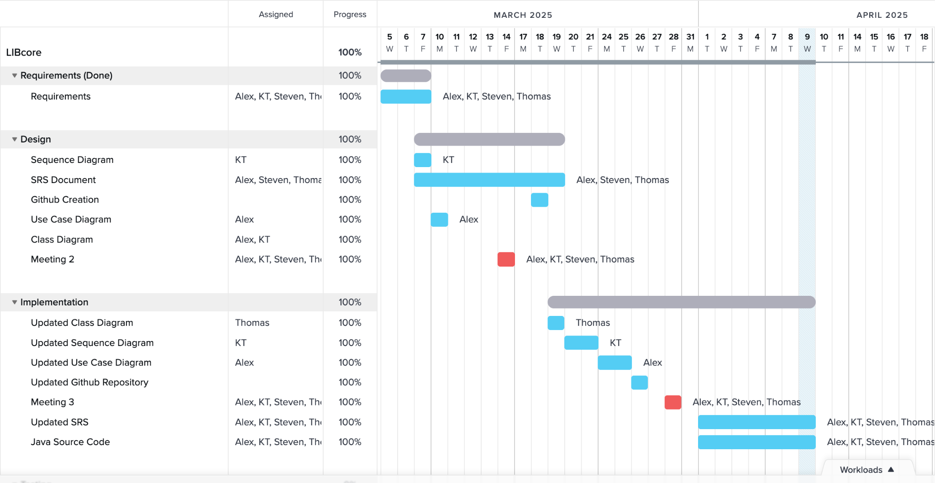
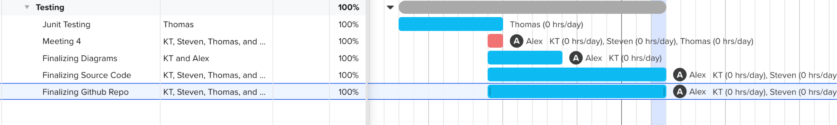
Group Tasks & Workload Schedule
1-2 Meetings were fridays in person

Slide 16
Things we could have done better
Make the program look prettier.
Ability to have multiple library objects.
Account registration for new members.

Slide 17
Thank You!
Any Questions or Feedback?

